Slide 1
WHO Guideline on Antenatal Care (2016) Overview
Geneva, Switzerland
Reproductive Health and Research (RHR)
Nutrition for Health and Development (NHD)
Maternal, Newborn, Child and Adolescent Health (MCA)

Slide 2
Outline
Background
Development of the WHO ANC guideline
Recommendations
What's new
Implementation, research and monitoring & evaluation (M&E)

Slide 3

BACKGROUND

Slide 4
ANC is critical
Through timely and appropriate evidence-based actions related to health promotion, disease prevention, screening, and treatment
Reduces complications from pregnancy and childbirth
Reduces stillbirths and perinatal deaths
Integrated care delivery throughout pregnancy

Slide 5
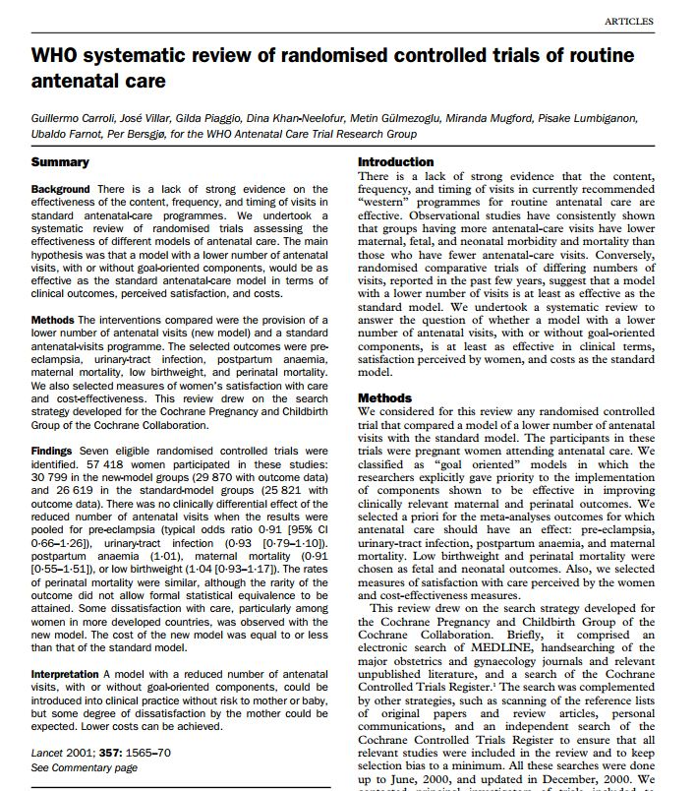
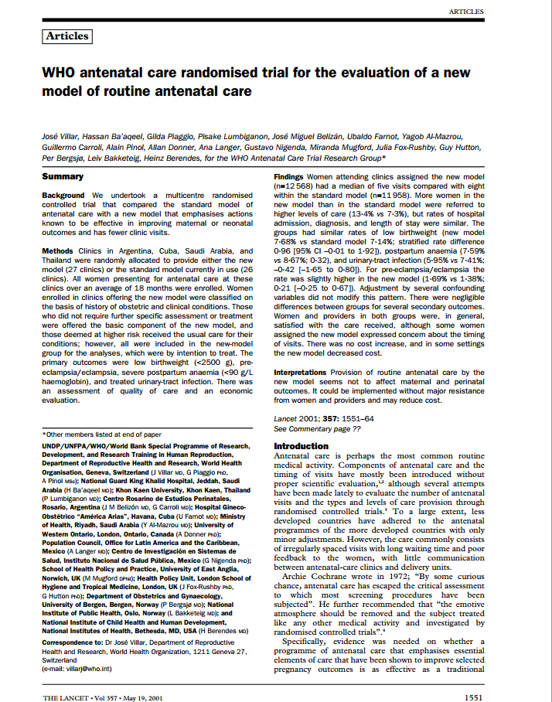
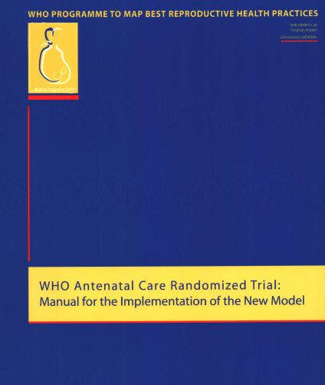
Previously: The 4-visit WHO ANC model
Involves specific evidence-based interventions for all women
Carried out at four critical times
Also known as the Focused Antenatal Care Model (FANC)
Part of Pregnancy, Childbirth, Postpartum and Newborn Care (PCPNC)

Slide 6
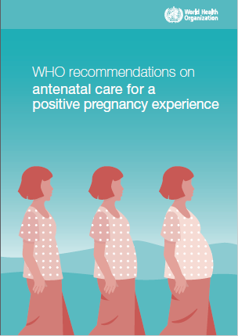
QUALITY throughout the continuum of care
WHO envisions a world where “every pregnant woman and newborn receives quality care throughout the pregnancy, childbirth and the postnatal period”.
Prioritizes person-centred health and well-being:
Reducing mortality and morbidity
Providing respectful care that takes into account woman’s views
Optimizing service delivery within health systems

Slide 7
Women’s views
Women want a
Positive Pregnancy Experience
from ANC
A healthy pregnancy for mother and baby (including preventing or treating risks, illness and death)
Physical and sociocultural normality during pregnancy
Effective transition to positive labour and birth
Positive motherhood (including maternal self-esteem, competence and autonomy)
Medical care; relevant and timely information; emotional support and advice
Downe S et al, 2016

Slide 8
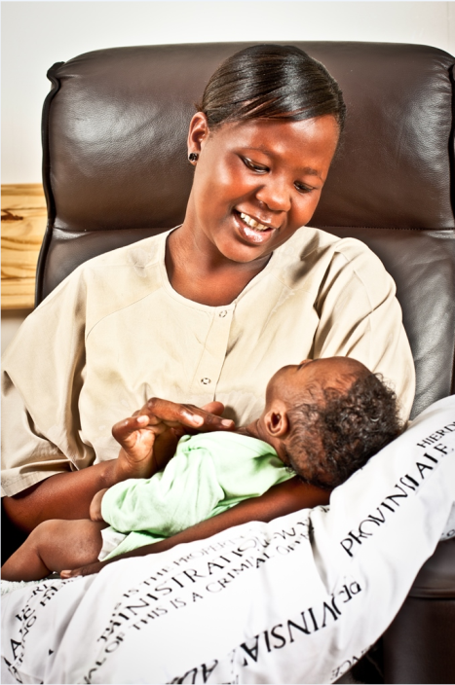
Development of the Guideline

Slide 9
The 2016 ANC guideline
Essential core package of ANC that all pregnant women and adolescent girls should receive
With the flexibility to employ different options based on the context of different countries
What is the content of the model/package?
Who provides care?
Where is the care provided?
How is the care provided to meet the needs of the users?
Complement existing WHO guidance on complications during pregnancy
Overarching questions
What are the evidence-based practices during ANC that improved outcomes and lead to positive pregnancy experience?
How should these practices be delivered?

Slide 10
Work streams for guideline evidence syntheses
Individual interventions
Antenatal testing
Barriers and facilitators to access to and provision of ANC
Health systems interventions
Large scale WHO ANC model (4-visit) case studies
Notes:
Work streams were created as part of the ANC working group on each of these areas to synthesize evidence and populate the DECIDE frameworks for each PICO question.

Slide 11
Methodology and assessment of evidence
Work streams | Methodology | Assessment of evidence
Individual interventions for clinical practices (n=37) | Effectiveness reviews, systematic reviews | GRADE
Antenatal testing (n=2) | Test accuracy reviews | GRADE
Barriers and facilitators to access to and provision of ANC (n=2) | Qualitative evidence synthesis | GRADE-CERQual
Health systems interventions to improve the utilization and quality of ANC (n=6) | Effectiveness reviews | GRADE
Large scale WHO ANC model (4-visit) case studies | Mixed-methods review, focusing on contextual and health system factors affecting implementation | N/A

Slide 12
The DECIDE framework
RECOMMENDATION
Resource use
Values
Acceptability
Feasibility
Benefits and harms
Equity
Three technical consultations with guideline development group
(October 2015-March 2016)
Collaborative effort between WHO departments, methodologists and different groups of experts
http://ietd.epistemonikos.org/
Notes:
The DECIDE framework is a new tool to support evidence-based decision making that allows for assessment of benefits and harms of an intervention, as well as assessment of values, equity, resource use, acceptability and feasibility.

Slide 13
Types of recommendations
We recommend the option
We recommend this option under certain conditions
Only in the context of rigorous research
Only with targeted monitoring and evaluation
Only in specific contexts
We do not recommend this option
Notes:
The GDG made three types of recommendations.

Slide 14

Recommendations on ANC
49 recommendations were grouped into five topic areas:
Nutritional interventions (14)
Maternal and fetal assessment (13)
Preventive measures (7)
Interventions for common physiological symptoms (6)
Health systems interventions to improve the utilization and quality of ANC (9)
Including 10 recommendations relevant to routine ANC from other WHO guidelines

Slide 15
A few remarks on the guideline document
Detailed methodology is provided for synthesizing and assessing different types of evidence
For each recommendation the evidence base included benefits and harms, values, equity, resource use, acceptability, feasibility
Remarks sections and implementation sections are crucial to each recommendation
Direct links are provided to other WHO guidelines
Recommendations are mapped to the 2016 ANC model for optimal timing of the recommended interventions
The ANC guideline is NOT a clinical practice manual
Guidance on good clinical practices (such as measuring maternal blood pressure, proteinuria and weight, and checking for fetal heart sounds) and established health promotion activities (such as family planning counselling and birth preparedness) can be found in the relevant WHO clinical practice manuals

Slide 16
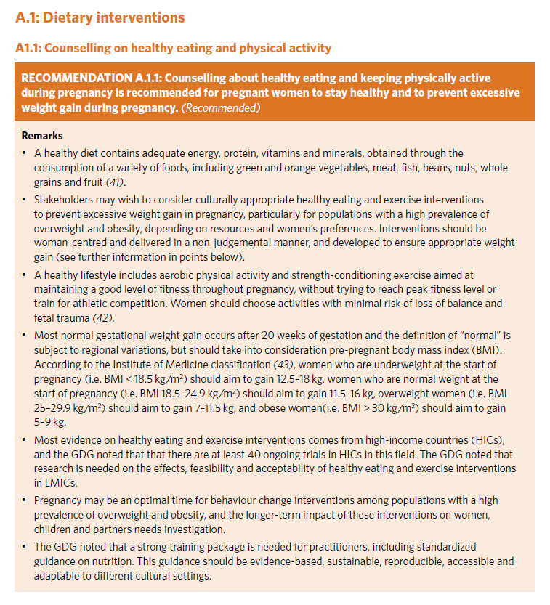
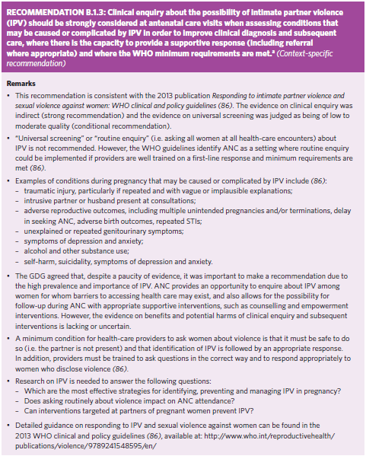
Examples

Slide 17
RECOMMENDATIONS

Slide 18

A. Nutritional interventions - 1
A.1.1: Counselling about healthy eating and keeping physically active during pregnancy is recommended for pregnant women to stay healthy and to prevent excessive weight gain during pregnancy. | Recommended
A.1.2: In undernourished populations, nutrition education on increasing daily energy and protein intake is recommended for pregnant women to reduce the risk of low-birth-weight neonates. | Context-specific recommendation
A.1.3: In undernourished populations, balanced energy and protein dietary supplementation is recommended for pregnant women to reduce the risk of stillbirths and small-for-gestational-age neonates. | Context-specific recommendation
A.1.4: In undernourished populations, high-protein supplementation is not recommended for pregnant women to improve maternal and perinatal outcomes. | Not recommended

Slide 19
A. Nutritional interventions -2
A.2.1: Daily oral iron and folic acid supplementation with 30 mg to 60 mg of elemental iron and 400 µg (0.4 mg) of folic acid is recommended for pregnant women to prevent maternal anaemia, puerperal sepsis, low birth weight, and preterm birth. | Recommended
A.2.2: Intermittent oral iron and folic acid supplementation with 120 mg of elemental iron and 2800 µg (2.8 mg) of folic acid once weekly is recommended for pregnant women to improve maternal and neonatal outcomes if daily iron is not acceptable due to side-effects, and in populations with an anaemia prevalence among pregnant women of less than 20%. | Context-specific recommendation
A.3: In populations with low dietary calcium intake, daily calcium supplementation (1.5–2.0 g oral elemental calcium) is recommended for pregnant women to reduce the risk of pre-eclampsia. | Context-specific recommendation
A.4: Vitamin A supplementation is only recommended for pregnant women in areas where vitamin A deficiency is a severe public health problem, to prevent night blindness. | Context-specific recommendation

Slide 20
Nutritional interventions - 3
A.5: Zinc supplementation for pregnant women is only recommended in the context of rigorous research. | Context-specific recommendation (research)
A.6: Multiple micronutrient supplementation is not recommended for pregnant women to improve maternal and perinatal outcomes. | Not recommended
A.7: Vitamin B6 (pyridoxine) supplementation is not recommended for pregnant women to improve maternal and perinatal outcomes. | Not recommended
A.8: Vitamin E and C supplementation is not recommended for pregnant women to improve maternal and perinatal outcomes. | Not recommended
A.9: Vitamin D supplementation is not recommended for pregnant women to improve maternal and perinatal outcomes. | Not recommended
A.10: For pregnant women with high daily caffeine intake (more than 300 mg per day), lowering daily caffeine intake during pregnancy is recommended to reduce the risk of pregnancy loss and low-birth-weight neonates. | Context-specific recommendation

Slide 21

B.1. Maternal assessment - 1
B.1.1: Full blood count testing is the recommended method for diagnosing anaemia in pregnancy. In settings where full blood count testing is not available, on-site haemoglobin testing with a haemoglobinometer is recommended over the use of the haemoglobin colour scale as the method for diagnosing anaemia in pregnancy. | Context-specific recommendation
B.1.2: Midstream urine culture is the recommended method for diagnosing asymptomatic bacteriuria (ASB) in pregnancy. In settings where urine culture is not available, on-site midstream urine Gram-staining is recommended over the use of dipstick tests as the method for diagnosing ASB in pregnancy. | Context-specific recommendation
B.1.3: Clinical enquiry about the possibility of intimate partner violence (IPV) should be strongly considered at antenatal care visits when assessing conditions that may be caused or complicated by IPV in order to improve clinical diagnosis and subsequent care, where there is the capacity to provide a supportive response (including referral where appropriate) and where the WHO minimum requirements are met. | Context-specific recommendation

Slide 22
B.1. Maternal assessment - 2
B.1.4: Hyperglycaemia first detected at any time during pregnancy should be classified as either gestational diabetes mellitus (GDM) or diabetes mellitus in pregnancy, according to WHO criteria. | Recommended
B.1.5: Health-care providers should ask all pregnant women about their tobacco use (past and present) and exposure to second-hand smoke as early as possible in the pregnancy and at every antenatal care visit. | Recommended
B.1.6: Health-care providers should ask all pregnant women about their use of alcohol and other substances (past and present) as early as possible in the pregnancy and at every antenatal care visit. | Recommended
B.1.7: In high-prevalence settings, provider-initiated testing and counselling (PITC) for HIV should be considered a routine component of the package of care for pregnant women in all antenatal care settings. In low-prevalence settings, PITC can be considered for pregnant women in antenatal care settings as a key component of the effort to eliminate mother-to-child transmission of HIV, and to integrate HIV testing with syphilis, viral or other key tests, as relevant to the setting, and to strengthen the underlying maternal and child health systems. | Recommended
B.1.8: In settings where the tuberculosis (TB) prevalence in the general population is 100/100 000 population or higher, systematic screening for active TB should be considered for pregnant women as part of antenatal care. | Context-specific recommendation
Notes:
Recommendations B1.4 to B1.8 have been integrated into the ANC guideline from other recent WHO guidelines

Slide 23
B.2.Fetal assessment
B.2.1: Daily fetal movement counting, such as with “count-to-ten” kick charts, is only recommended in the context of rigorous research. | Context-specific recommendation (research)
B.2.2: Replacing abdominal palpation with symphysis-fundal height (SFH) measurement for the assessment of fetal growth is not recommended to improve perinatal outcomes. A change from what is usually practiced (abdominal palpation or SFH measurement) in a particular setting is not recommended. | Context-specific recommendation
B.2.3: Routine antenatal cardiotocography is not recommended for pregnant women to improve maternal and perinatal outcomes. | Not recommended
B.2.4: One ultrasound scan before 24 weeks of gestation (early ultrasound) is recommended for pregnant women to estimate gestational age, improve detection of fetal anomalies and multiple pregnancies, reduce induction of labour for post-term pregnancy, and improve a woman’s pregnancy experience. | Recommended
B.2.5: Routine Doppler ultrasound examination is not recommended for pregnant women to improve maternal and perinatal outcomes. | Not recommended

Slide 24

C. Preventive measures - 1
C.1: A seven-day antibiotic regimen is recommended for all pregnant women with asymptomatic bacteriuria (ASB) to prevent persistent bacteriuria, preterm birth and low birth weight. | Recommended
C.2: Antibiotic prophylaxis is only recommended to prevent recurrent urinary tract infections in pregnant women in the context of rigorous research. | Context-specific recommendation (research)
C.3: Antenatal prophylaxis with anti-D immunoglobulin in non-sensitized Rh-negative pregnant women at 28 and 34 weeks of gestation to prevent RhD alloimmunization is only recommended in the context of rigorous research. | Context-specific recommendation (research)
C.4: In endemic areas, preventive anthelminthic treatment is recommended for pregnant women after the first trimester as part of worm infection reduction programmes. | Context-specific recommendation
C.5: Tetanus toxoid vaccination is recommended for all pregnant women, depending on previous tetanus vaccination exposure, to prevent neonatal mortality from tetanus. | Recommended

Slide 25
C. Preventive measures - 2
C.6: In malaria-endemic areas in Africa, intermittent preventive treatment with sulfadoxine-pyrimethamine (IPTp-SP) is recommended for all pregnant women. Dosing should start in the second trimester, and doses should be given at least one month apart, with the objective of ensuring that at least three doses are received. | Context-specific recommendation
C.7: Oral pre-exposure prophylaxis (PrEP) containing tenofovir disoproxil fumarate (TDF) should be offered as an additional prevention choice for pregnant women at substantial risk of HIV infection as part of combination prevention approaches. | Context-specific recommendation
Notes:
Recommendations B1.4 to B1.8 have been integrated into the ANC guideline from other recent WHO guidelines

Slide 26

D. Common physiological symptoms
D.1: Ginger, chamomile, vitamin B6 and/or acupuncture are recommended for the relief of nausea in early pregnancy, based on a woman’s preferences and available options. | Recommended
D.2: Advice on diet and lifestyle is recommended to prevent and relieve heartburn in pregnancy. Antacid preparations can be offered to women with troublesome symptoms that are not relieved by lifestyle modification. | Recommended
D.3: Magnesium, calcium or non-pharmacological treatment options can be used for the relief of leg cramps in pregnancy, based on a woman’s preferences and available options. | Recommended
D.4: Regular exercise throughout pregnancy is recommended to prevent low back and pelvic pain. There are a number of different treatment options that can be used, such as physiotherapy, support belts and acupuncture, based on a woman’s preferences and available options. | Recommended
D.5: Wheat bran or other fibre supplements can be used to relieve constipation in pregnancy if the condition fails to respond to dietary modification, based on a woman’s preferences and available options. | Recommended
D.6: Non-pharmacological options, such as compression stockings, leg elevation and water immersion, can be used for the management of varicose veins and oedema in pregnancy, based on a woman’s preferences and available options. | Recommended

Slide 27

E. Health systems interventions to improve the utilization and quality of ANC – 1
E.1: It is recommended that each pregnant woman carries her own case notes during pregnancy to improve continuity, quality of care and her pregnancy experience. | Recommended
E.2: Midwife-led continuity-of-care models, in which a known midwife or small group of known midwives supports a woman throughout the antenatal, intrapartum and postnatal continuum, are recommended for pregnant women in settings with well functioning midwifery programmes. | Context-specific recommendation
E.3: Group antenatal care provided by qualified health-care professionals may be offered as an alternative to individual antenatal care for pregnant women in the context of rigorous research, depending on a woman’s preferences and provided that the infrastructure and resources for delivery of group antenatal care are available. | Context-specific recommendation (research)

Slide 28
E. Health systems interventions to improve the utilization and quality of ANC – 2
E.4.1: The implementation of community mobilization through facilitated participatory learning and action (PLA) cycles with women’s groups is recommended to improve maternal and newborn health, particularly in rural settings with low access to health services. Participatory women’s groups represent an opportunity for women to discuss their needs during pregnancy, including barriers to reaching care, and to increase support to pregnant women. | Context-specific recommendation
E.4.2: Packages of interventions that include household and community mobilization and antenatal home visits are recommended to improve antenatal care utilization and perinatal health outcomes, particularly in rural settings with low access to health services. | Context-specific recommendation

Slide 29
E. Health systems interventions to improve the utilization and quality of ANC – 3
E.5.1: Task shifting the promotion of health-related behaviours for maternal and newborn health to a broad range of cadres, including lay health workers, auxiliary nurses, nurses, midwives and doctors is recommended. | Recommended
E.5.2: Task shifting the distribution of recommended nutritional supplements and intermittent preventative treatment in pregnancy (IPTp) for malaria prevention to a broad range of cadres, including auxiliary nurses, nurses, midwives and doctors is recommended. | Recommended
E.6: Policy-makers should consider educational, regulatory, financial, and personal and professional support interventions to recruit and retain qualified health workers in rural and remote areas. | Context-specific recommendation

Slide 30
E. Health systems interventions to improve the utilization and quality of ANC – 4
E.7: Antenatal care models with a minimum of eight contacts are recommended to reduce perinatal mortality and improve women’s experience of care. | Recommended

Slide 31
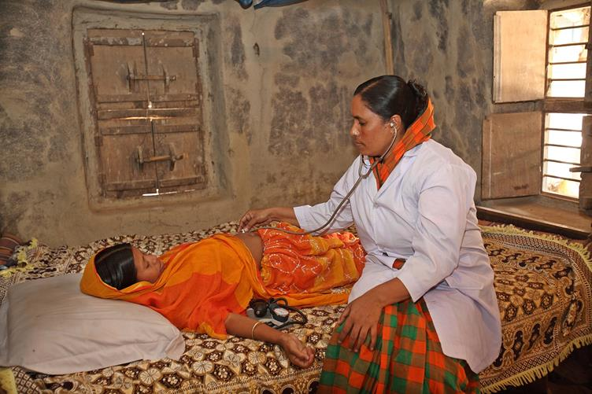
WHAT's NEW?

Slide 32
E.7: Antenatal care models with a minimum of eight contacts are recommended to reduce perinatal mortality and improve women’s experience of care.
1
This GDG recommendation was informed by:
Evidence suggesting increased perinatal deaths in 4-visit ANC model
Evidence supporting improved safety during pregnancy through increased frequency of maternal and fetal assessment to detect complications
Evidence supporting improved health system communication and support around pregnancy for women and families
Evidence indicating that more contact between pregnant women and respectful, knowledgeable health care workers is more likely to lead to a positive pregnancy experience
Evidence from HIC studies indicating no important differences in maternal and perinatal health outcomes between ANC models that included at least eight contacts and ANC models that included 11 to 15 contacts.

Slide 33
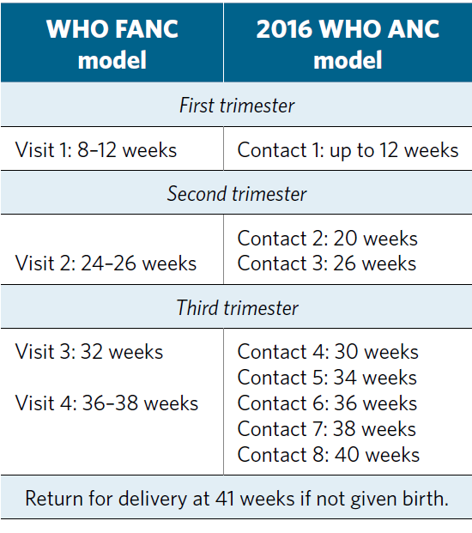
2016 WHO ANC model

Slide 34
Contact versus visit
2
The guideline uses the term ‘contact’ - it implies an active connection between a pregnant woman and a health care provider that is not implicit with the word ‘visit’.
quality care including medical care, support and timely and relevant information
In terms of the operationalization of this recommendation, ‘contact’ can take place at the facility or at community level
be adapted to local context through health facilities or community outreach services
‘Contact’ helps to facilitate context-specific recommendations
Interventions (such as malaria, tuberculosis)
Health system (such as task shifting)

Slide 35
Early ultrasound
3
In the new WHO ANC guideline, an ultrasound scan before 24 weeks’ gestation is recommended for all pregnant women to:
estimate gestational age
detect fetal anomalies and multiple pregnancies
enhance the maternal pregnancy experience
An ultrasound scan after 24 weeks’ gestation (late ultrasound) is not recommended for pregnant women who have had an early ultrasound scan.
Stakeholders should consider offering a late ultrasound scan to pregnant women who have not had an early ultrasound scan.
Ultrasound equipment can also used for other indications (e.g. obstetric emergencies) or by other medical departments
The implementation and impact of this recommendation on health outcomes, facility utilization, and equity should be monitored at the health service, regional, and country level
based on clearly defined criteria and indicators associated with locally agreed and appropriate targets.

Slide 36
ANC model – positive pregnancy experience
4
Overarching aim
To provide pregnant women with respectful, individualized, person-centred care at every contact, with implementation of effective clinical practices (interventions and tests), and provision of relevant and timely information, and psychosocial and emotional support, by practitioners with good clinical and interpersonal skills within a
well functioning health system.

Slide 37
Effective implementation of ANC requires
5
Health systems approach and strengthening
Continuity of care
Integrated service delivery
Improved communication with, and support for women
Availability of supplies and commodities
Empowered health care providers
Recruitment and retention of staff in rural and remote areas
Capacity building

Slide 38
Implementation and dissemination

Slide 39
Implementation, research and M&E - 1
Adoption, adaptation and implementation of the ANC model
Essential core package of ANC that all pregnant women and adolescent girls should receive
With the flexibility to employ different options based on the context and needs of different countries
What is the content of the model/package?
Who provides care?
Where is the care provided?
How is the care provided to meet the needs of the users?

Slide 40

Implementation, research and M&E – 2
Implementation considerations
Throughout adaptation and implementation at country level – monitoring and evaluation (M&E) and learning will be crucial
Development of indicators
Priority research questions

Slide 41
Dissemination
Policy briefs
ANC model
Early USG
Others (in the works)
Interactive website
Tools for implementation
Regional dissemination workshops
Translation of the guideline
Webinar

Slide 42
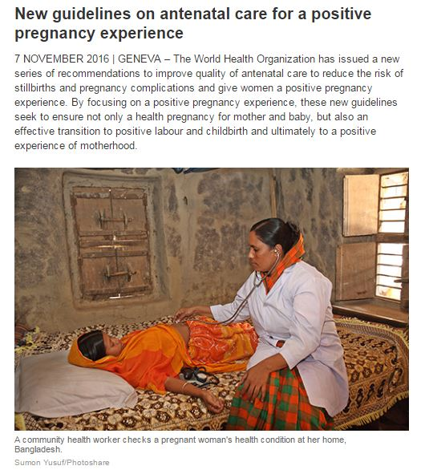
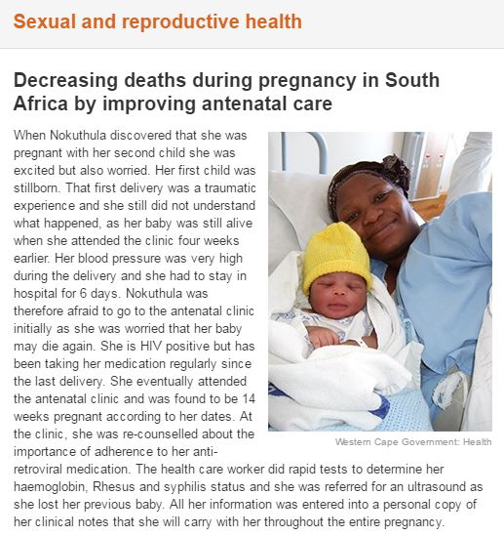
Relevant links – 1
About the guidelines:
www.who.int/reproductivehealth/news/antenatal-care/en/index.html
South Africa story from the field:
www.who.int/reproductivehealth/news/antenatal-care-south-africa/en/index.html
The guideline
www.who.int/reproductivehealth/publications/maternal_perinatal_health/anc-positive-pregnancy-experience/en/
Press release
www.who.int/entity/mediacentre/news/releases/2016/antenatal-care-guidelines/en/index.html

Slide 43
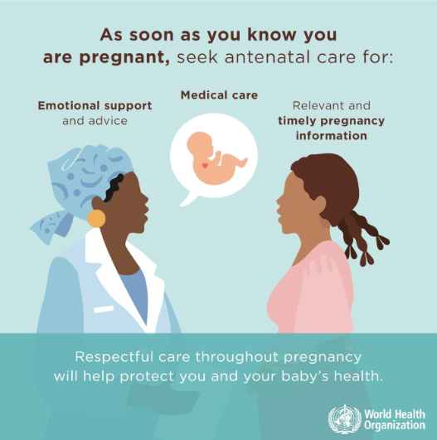
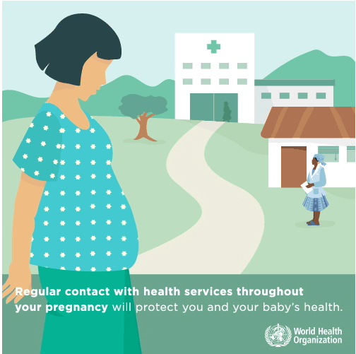
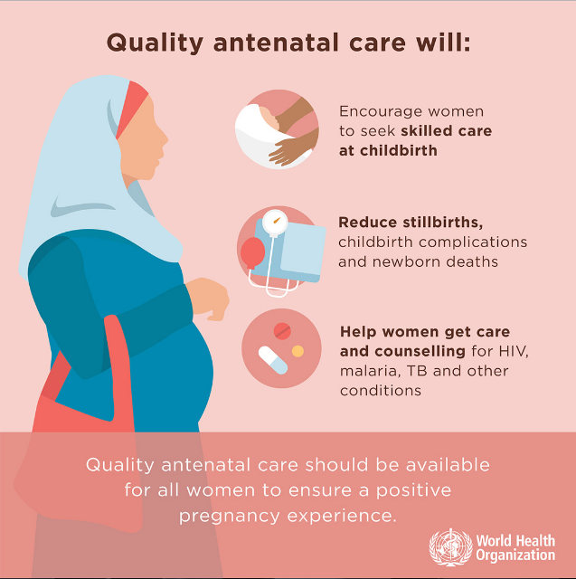
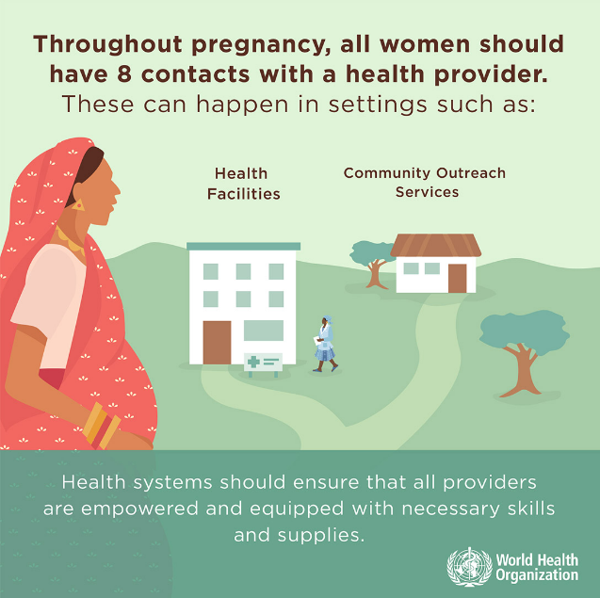
Relevant links – 2
Infographics
www.who.int/reproductivehealth/publications/maternal_perinatal_health/ANC_infographics/en/index.html

Slide 44
Many thanks to…
Internal and external reviewers
Andrea Bosman, Maurice Bucagu, Jahnavi Daru, Claudia Garcia-Moreno, Haileyesus Getahun, Rodolfo Gomez, Tracey Goodman, Tamar Kabakian, Avinash Kanchar, Philipp Lambach, Sarah de Masi, Frances McConville, Antonio Montresor, Justin Ortiz, Anayda Portela, Jeremy Pratt, Lisa Rogers, Nathalie Roos, Silvia Schwarte, Maria Pura Solon, João Paulo Souza, Petr Velebil , Ahmadu Yakubu, Yacouba Yaro, Teodora Wi and Gerardo Zamora
Observers
France Donnay (BMGF), Rita Borg-Xuereb (ICM), Diogo Ayres-de-Campos and CN Purandare (FIGO), Luc de Bernis (UNFPA), Roland Kupka (UNICEF), Deborah Armbruster and Karen Fogg (USAID)
WHO ANC Technical Working Group
Edgardo Abalos, Emma Allanson, Monica Chamillard, Virginia Diaz , Soo Downe, Kenny Finlayson, Claire Glenton, Ipek Gurol-Urganci, Sonja Henderson, Frances Kellie, Khalid Khan, Theresa Lawrie, Simon Lewin, Nancy Medley, Jenny Moberg, Charles O'Donovan, Ewelina Rogozinska and Inger Scheel
WHO Steering Group
A. Metin Gülmezoglu (RHR), Matthews Mathai (MCA), Olufemi Oladapo (RHR), Juan Pablo Peña-Rosas (NHD), Ӧzge Tunçalp (RHR)
Members of the GDG
Mohammed Ariful Aram, Françoise Cluzeau, Luz Maria De-Regil, Aft Ghérissi, Gill Gyte, Rintaro Mori, James Neilson, Lynnette Neufeld, Lisa Noguchi, Nafissa Osman, Erika Ota, Tomas Pantoja, Bob Pattinson, Kathleen Rasmussen, Niveen Abu Rmeileh, Harshpal Singh Sachdev, Rusidah Selamat, Charlotte Warren, Charles Wisonge and James Neilson
WHO regional advisors
Karima Gholbzouri, Gunta Lazdane, Bremen de Mucio, Mari Nagai, Leopold Ouedraogo, Neena Raina and Susan Serruya
Technical contributions (incl scoping)
Manzi Anatole, Rifat Atun, Himanshu Bhushan, Jacquelyn Caglia, Chompilas Chongsomchai, Morseda Chowdhury, Mengistu Hailemariam, Stephen Hodgins, Annie Kearns, Rajat Khosla, Ana Langer, Pisake Lumbiganon, Taiwo Oyelade, Jeffrey Smith, Petra ten Hoope-Bender, James Tielsch and Rownak Khan

Slide 45
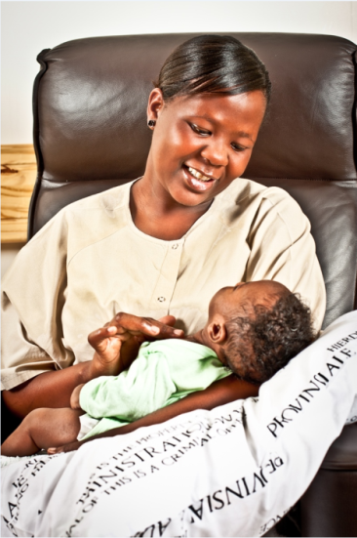

"To achieve the Every Woman Every Child vision and the Global Strategy for Women's Children's and Adolescents' Health, we need innovative, evidence-based approaches to antenatal care. I welcome these guidelines, which aim to put women at the centre of care, enhancing their experience of pregnancy and ensuring that babies have the best possible start in life."
Ban Ki-moon, UN Secretary-General

Slide 46
For further information
Dr Özge Tunçalp in RHR at tuncalpo@who.int
Dr Maurice Bucagu in MCA at bucagum@who.int
Dr Juan Pablo Peñas-Rosas in NHD at penarosasj@who.int

